Slide 1
Introduction to DevOps
Sonika Rathi
Assistant Professor
BITS Pilani

Slide 2
Agenda
DevOps and Agile
Relationship of DevOps practices to agile practices
DevOps Practices over Agile
Traditional, Agile and DevOps – A comparison

Slide 3
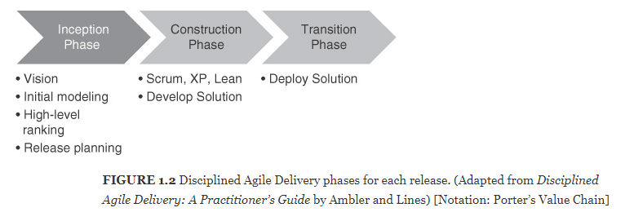
DevOps and Agile
Relationship of DevOps practices to agile practices
One of the characterizations of DevOps emphasizes the relationship of DevOps practices to agile practices
We will focus on what is added by DevOps
We interpret transition as deployment

Slide 4
DevOps and Agile Contd..
DevOps Practices over Agile
DevOps practices impact all three phases
Inception phase : During the inception phase, release planning and initial requirements specification are done
Considerations of Ops will add some requirements for the developers
Release planning includes feature prioritization but it also includes coordination with operations personnel
Construction phase: During the construction phase, key elements of the DevOps practices are the management of the code branches,
the use of continuous integration
continuous deployment
incorporation of test cases for automated testing
Transition phase: In the transition phase, the solution is deployed and the development team is responsible for the deployment, monitoring the process of the deployment, deciding whether to roll back and when, and monitoring the execution after deployment

Slide 5

DevOps and Agile Contd..
Traditional, Agile and DevOps – A comparison
Agile breaks the wall between Business and Development team
DevOps breaks the wall between Development and Operations team
DevOps centers on the concept of sharing: sharing ideas, issues, processes, tools and goals
Traditional wall Between Main Stakeholders
Business
Design
Code
QA
Operations
Inception Elaboration Construction Transition
Agile Development
Elaboration Construction Transition Operations
DevOps

Slide 6
Thank You!
In our next session:

